Slide 1
Creating a ClearPath for Atlanta’s Homeless
Atlanta Regional Housing Forum
March 6, 2018

Slide 2
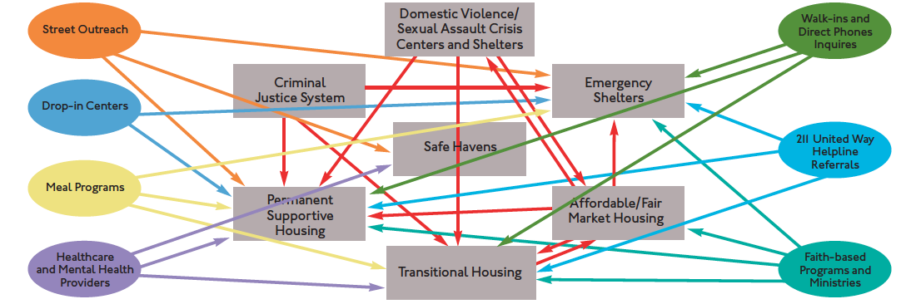
Previous Ecosystem
the way a homeless person accessed services previously:

Slide 3
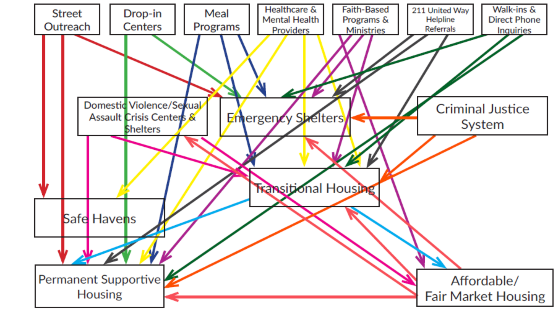
Funding Was Equally Inefficient
the way a homeless person accessed services previously:

Slide 4
Evolution to a Coordinated System
Programs
Prior: Diverse group of independent providers using lots of methods to achieve various goals
Crisis response system
Vision: A collective network of providers aligning coordinated efforts and resources to maximize impact

Slide 5
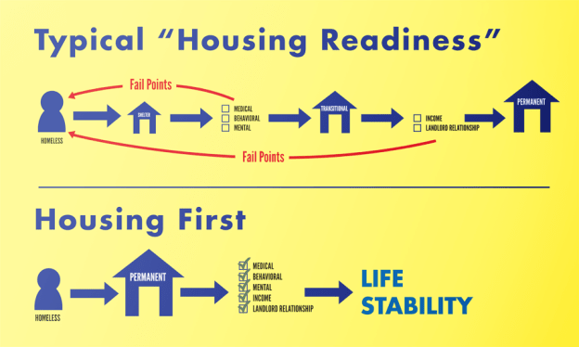
Using Housing First as our foundation
Source: How’s Nashville, Housing to End Homelessness, http://howsnashville.org/2016/05/31/housing-first/

Slide 6
Key Terms Glossary
Emergency shelter – short term bridge housing to other assistance; for all
Transitional housing – long term temporary housing (6-24 months) with intensive services. Ideally suited for domestic violence, youth, and substance abuse
Rapid rehousing – Time-limited rental assistance and case management to help people experiencing
homelessness find private-market housing & quickly re-house and stabilize individuals and families
Permanent Supportive Housing – evidence based housing intervention that combines non-time-limited housing assistance with intensive wrap around supportive services. Ideal for chronically homeless
Chronic homelessness—an individual who has a disabling condition AND has been homeless for the last 12 months or had 4 episodes in last 3 years = 12 month
Continuum of Care, or CoC—Regional or local planning body that coordinates housing and services
funding from the US Department of Housing and Urban Development (HUD).
Coordinated entry—A process through which people experiencing or at risk of homelessness access resources in the homeless assistance system. It includes access points for all types of assistance, a standardized assessment process, and referrals to appropriate housing and community services. Coordinated entry is required by HUD of every CoC.
Housing first—evidence based practice and philosophical approach to housing individuals experiencing homelessness without preconditions and barriers to entry such as sobriety, treatment or service participation requirements

Slide 7
By the Numbers

Slide 8
Historical HUD Homeless Count
Atlanta’s unsheltered count has been reduced by over 67%
Total count has decreased by more than 40%

Slide 9
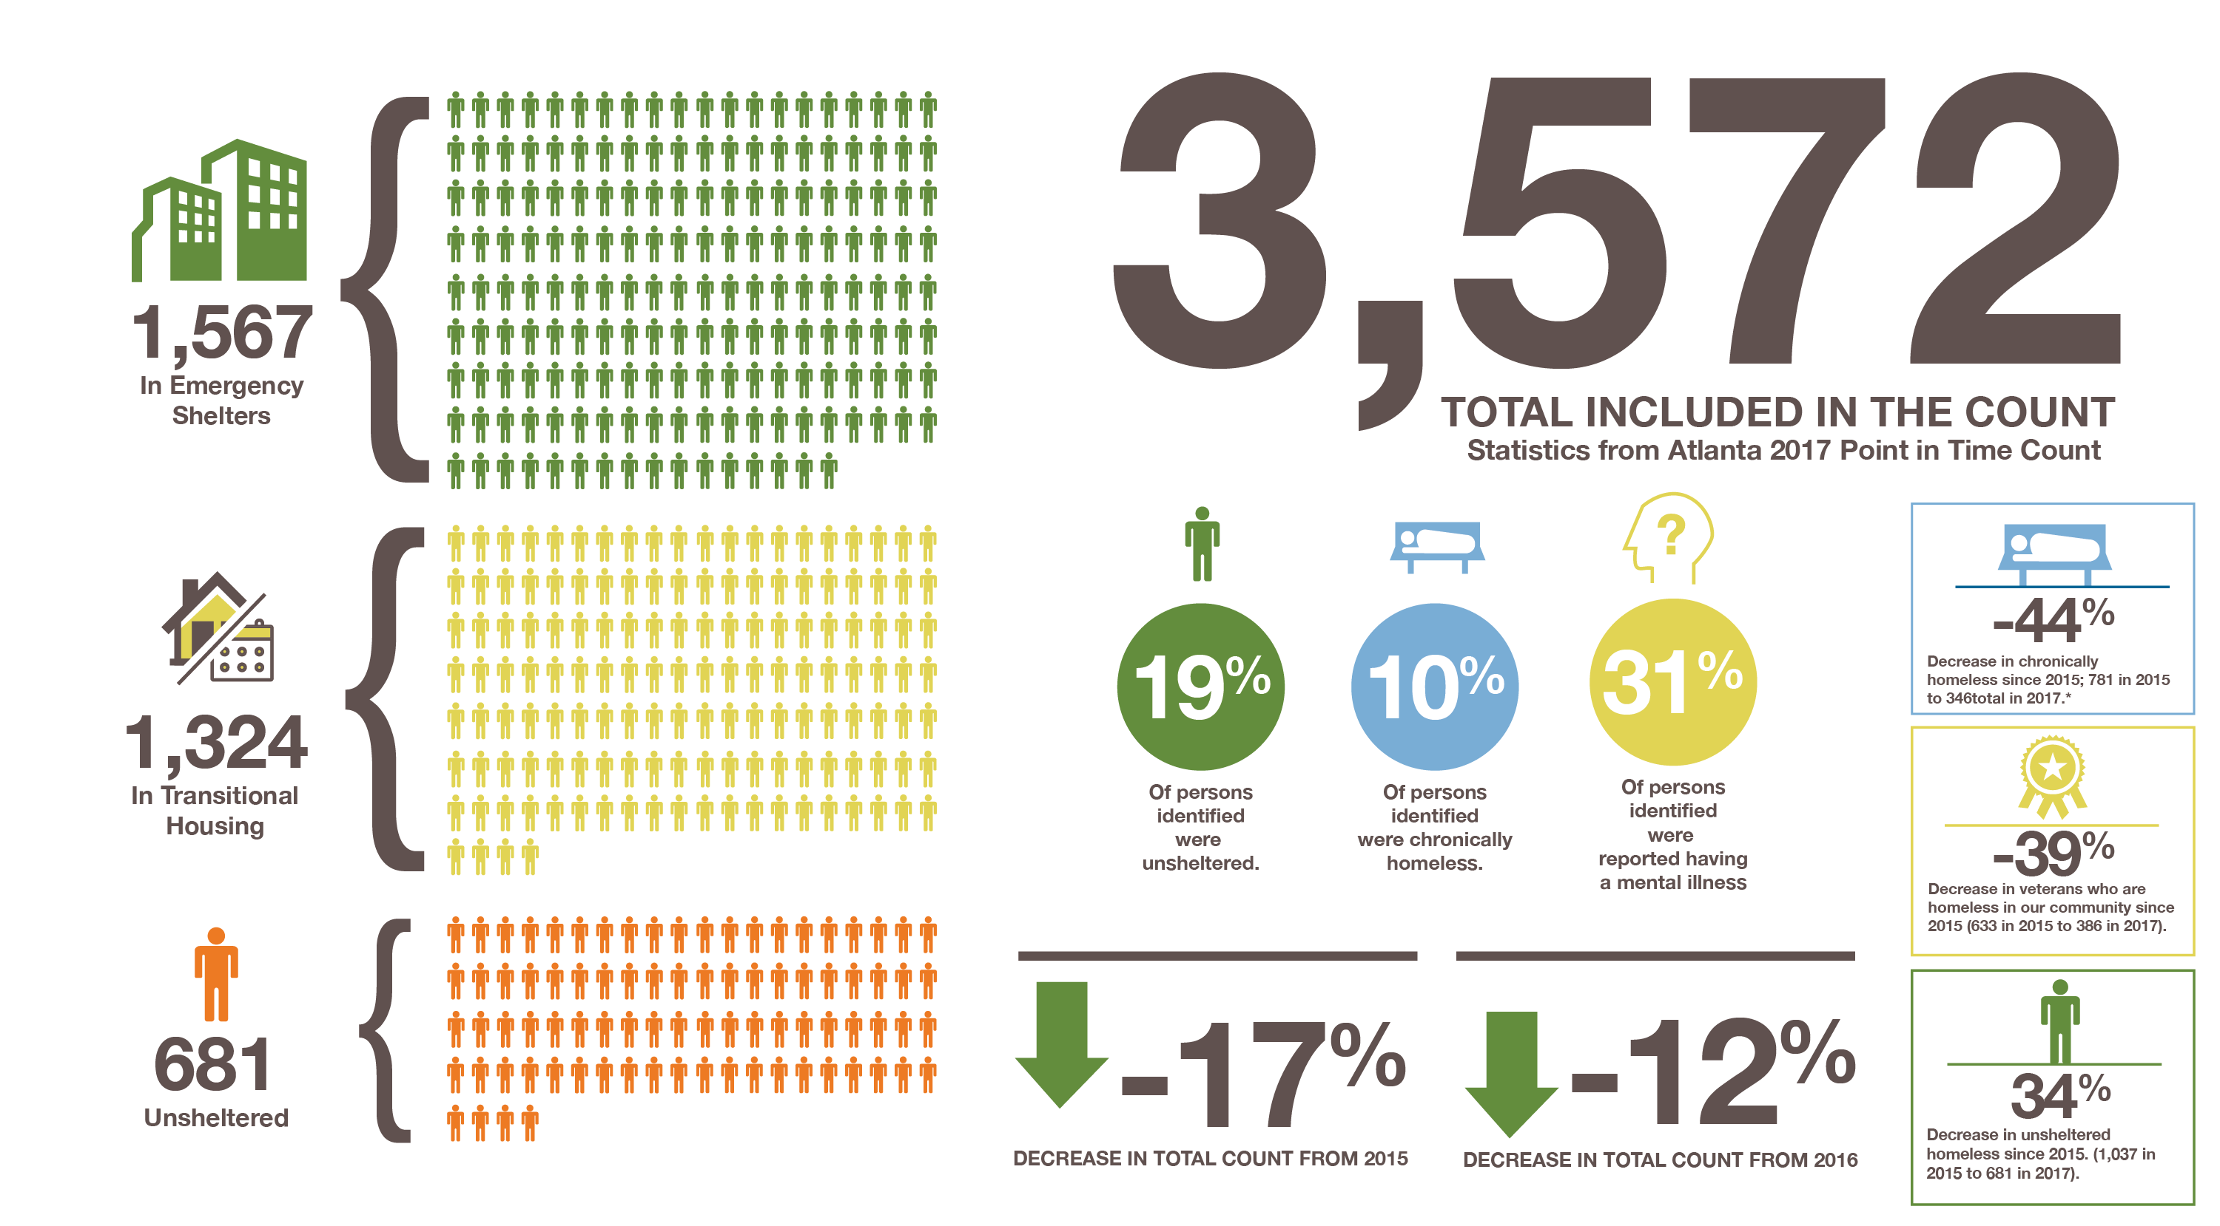
What Homelessness In Atlanta Looks Like:
Notes:
Point out Chronic Status and Mental Health

Slide 10
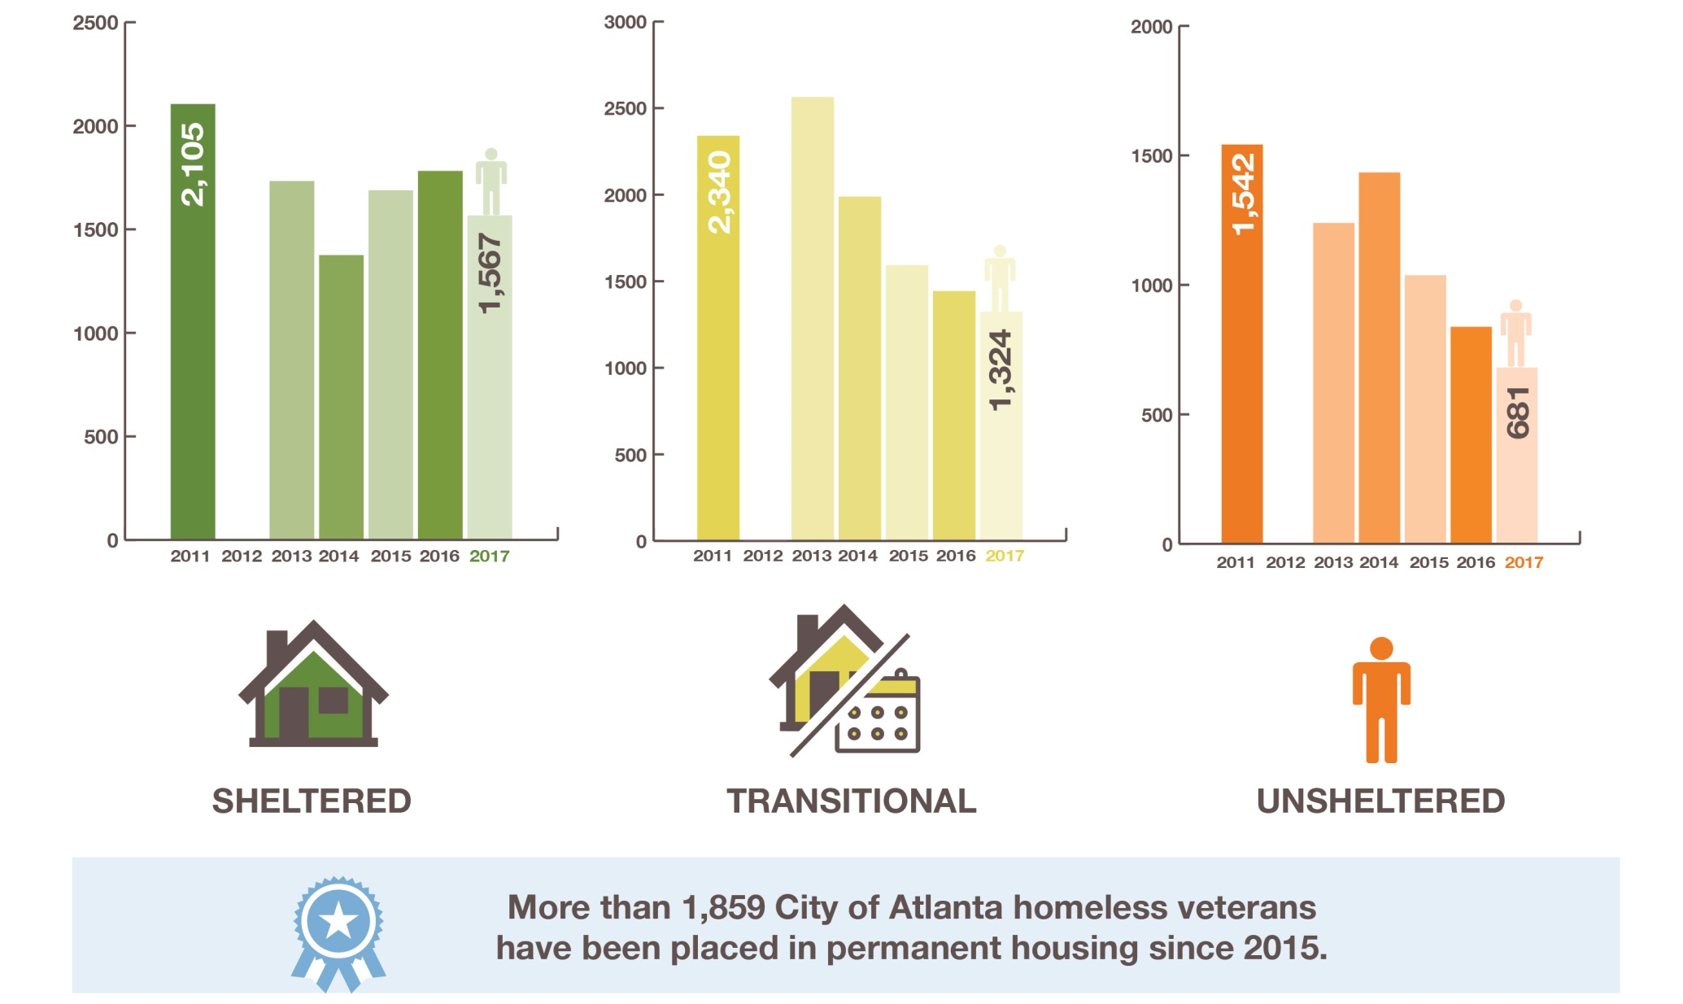
Substantial progress in decreasing homelessness in recent years
**PIT count not conducted in 2012
Notes:
All sub pops also decreased with the exception of Families which increase from 141 to 163
Youth 217 down from 342
Vets 386
Chronics at 346 down from 538

Slide 11
Trends 2013-2017:
Total Population for Cobb, Fulton and Dekalb
Source: HUD Exchange, https://www.hudexchange.info/programs/coc/coc-homeless-populations-and-subpopulations-reports/?filter_Year=2017&filter_Scope=CoC&filter_State=GA&filter_CoC=&program=CoC&group=PopSub
Notes:
Fulton stayed stagnant; Dekalb and Cobb saw declines

Slide 12
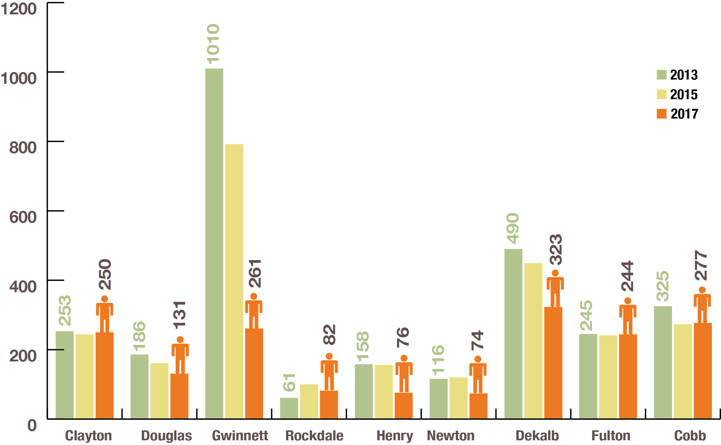
Trends 2013-2017:
Total Homeless by County, Metro
Source: DCA Homelessness Report 2013, 2015, and 2017
Notes:
Clayton: stagnant
Rockdale: up
Gwinnett: drastic drop

Slide 13
ClearPath: Guiding principles

Slide 14
Big Goals:
Achieved by the new system design and collective impact model
Goal: Rare, brief and nonrecurring | Timeline
End Veteran Homelessness | 2017 – Met, now sustain
End Chronic Homelessness | 2019
End Youth Homelessness | 2020
End Family Homelessness | 2020
Leverage, align and strategically allocate resources | Ongoing

Slide 15
Guiding Principle 1
1
Disrupt and Refine the System
Move the system from an independent – agency approach
to an integrated – partner approach
Gaps
Ending Homelessness | Stabilization
Housing stock | MH/SA
Low barrier shelter | Service revenue
Outreach, coordinated entry | Employment
 | Education
 | Transportation
 | Child care
Implement Coordinated Entry
Fill gaps
Address racial disparities

Slide 16
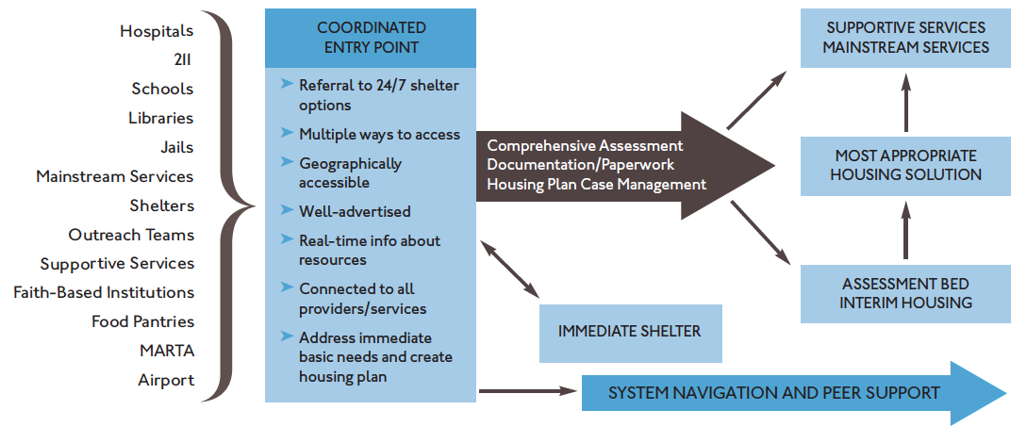
Coordinated Entry System Map

Slide 17

2
Guiding Principle 2
Create The Right-Sized Solutions
Modify and tailor housing entry and
support criteria by population
Using Housing First as our foundation:
Expand Supportive Housing
Rapid Rehousing
To Scale
Retool Transitional Housing
Affordable Housing Preservation
and refine integrated service delivery model utilizing Medicaid expansion for chronically homeless
for non-chronic singles and families. Sustain with TANF, ESG, CoC
for youth, domestic abuse, and substance abuse populations
and development aligned/supported with policy

Slide 18

Strengthen our Crisis Response System
Crisis response system:
Increase low barrier shelter capacity:
  Opened 2017:
    +100 bed LBS for men—the Evolution Center
    +14 bed LBS for families—Weaver Gardens
  Opening 4/2018: 35 bed LBS for women and families—Donna Center
  Proposed: 30 bed LBS for families

Slide 19

Invest in Permanent Housing and Stabilization to End Homelessness
Chronically homeless
Permanent Supportive Housing
  Supportive housing pipeline
  1000 placements; 550+ developed units
  Secure service dollars through Medicaid
  PSH = evidence based housing intervention that combines non-time-limited housing assistance with intensive wrap around supportive services.
  IDEAL FOR CHRONICALLY HOMELESS

Slide 20
PSH yields results
Permanent housing subsidy + services
Most cost effective intervention for most costly consumers
82%
  Probation
  Emergency room
  Sheriff’s dept.
  Jail days
  Public benefits
  Emergency shelter
  Inpatient care
reduction in public costs
  $7100 - $38,046
Cost savings realized per person per year
Source: Flaming, 2009; Culhane, 2002; Larimer, 2009; Sadowski, 2009

Slide 21


Families
Taking Rapid Rehousing To Scale
  300+ interventions
  $500K+ leveraging TANF
Also, considering innovations for prevention in partnership with eviction legal assistance, a bridging affordability pilot, and innovative uses of vouchers.
Time-limited rental assistance and case management to help people experiencing homelessness find private-market housing and quickly re-house and stabilize individuals and families
Notes:
Also evlauting bridging affordability programs and prevention

Slide 22
Youth
Spectrum of Interventions: youth are different
  360+ interventions of youth specific rapid rehousing
  Host home model –pairing LGBTQ youth with LGBTQ families for temporary housing and services
  30+ units of independent living

Slide 23

3
Guiding Principle 3
Realign and Leverage Resources
Create an unprecedented public-private partnership
Transparent alignment
with city and state entitlement dollars across CoC system
Fiscal scan and gaps analysis
for accountability, needs-based redistribution and unmet needs rank list
Align funding decisions
of private sector grants with Collective Impact Model criteria

Slide 24
HUD CoC Funding, 2017
City | CoC Funding | Planning Grant (~2.8%)
Atlanta | $7.2 | $201,000
Orlando | $7.5 | $210,000
Minneapolis | $12.3 | $344,400
Dallas | $16.2 | $453,600
Portland | $22 | $616,000
Washington, DC | $22 | $616,000
Phoenix | $25 | $700,000
Denver | $25 | $700,000
Miami | $30.6 | $856,800
Houston | $33 | $924,000
Philadelphia | $33.8 | $946,400
Seattle | $35 | $980,000
Source: https://www.hud.gov/program_offices/comm_planning/homeless/budget/2017

Slide 25
Current Investment
Only ~25% of funding is spent on permanent solutions and…
…only ~20% and ~5% are spent on permanent supportive housing and rapid re-housing
Agency funding by category ($M)
Agency funding by type ($M)
Source: 2017 Service Provider Survey (N = 47);

Slide 26
Guiding Principle 4
4
Create a Performance-Driven System
Standardize uniform outcomes
2016 HUD Performance Measure | 2016 Atlanta CoC Performance
Percentage of exited participants with increased income at time of exit (all CoC funded projects) | 43%
Percentage of participants exiting emergency shelter to homelessness/emergency shelter | 85%
Percent of participants exiting transitional shelter to homelessness | 52%
Percentage of PSH participants who either remained in PSH or exited to permanent destinations | 91%
Use Evidence-based practices for decision making
Adopt Housing First philosophy across system
Monitor HMIS practices and data quality
Establish a system performance baseline and use data to project goals and timelines

Slide 27
Medicaid
Why Medicaid Waiver?
< 30% of individuals in permanent supportive housing (PSH) are insured
HUD pays operating, not ALL services; philanthropy pays capital
PSH cannot be sustained without ongoing revenue
Insufficient capacity with current indigent providers, e.g., ACT, ICM
Waiver can be designed to pay for services that keep people in housing, e.g., pre-tenancy services, move-in support, tenancy support + MH/SA
Return on investment: $40,000 on the streets vs. $19,600 in housing
Road already paved: Houston, Louisiana, Washington, Massachusetts
Homestretch funds are finite and will only jumpstart services

Slide 28
Long term sustainability critical
Innovative funding approaches
Airbnb tax: Chicago and Los Angeles; already generated $2.8MM in Chicago in first 12 months –supports family homelessness
Miami Restaurant tax: 1% on restaurants with revenue >$400K; generates $7MM/year
WA Family Fund: $2MM general fund matched by Gates foundation = $5MM annually
Utah Homeless Trust: legislated optional donation on individual tax return form (limited return)
State Housing Trust Funds: generate additional money from sustaining sources e.g. IL real estate transfer fee ($4.6MM/year), SC doc recording tax

Slide 29
The rub:
Stigma
Stereotypes
$$$
NIMBYism
Affordable Housing vs. Homelessness

